Slide 1

COMPUTER NETWORKS
Sivaraman Eswaran Ph.D.
Department of Computer Science and Engineering

Slide 2

COMPUTER NETWORKS
Computer Networks and the Internet
Sivaraman Eswaran Ph.D.
Department of Computer Science and Engineering

Slide 3
COMPUTER NETWORKS
OSI reference model
presentation: allow applications to interpret meaning of data, (e.g., encryption, compression, machine-specific conventions)
session: synchronization, checkpointing, recovery of data exchange
Internet stack “missing” these layers!
these services, if needed, must be implemented in application
needed?
application
presentation
session
transport
network
link
physical
Open Systems Interconnection (OSI) model – introduced in late 1970s by ISO.

Slide 4
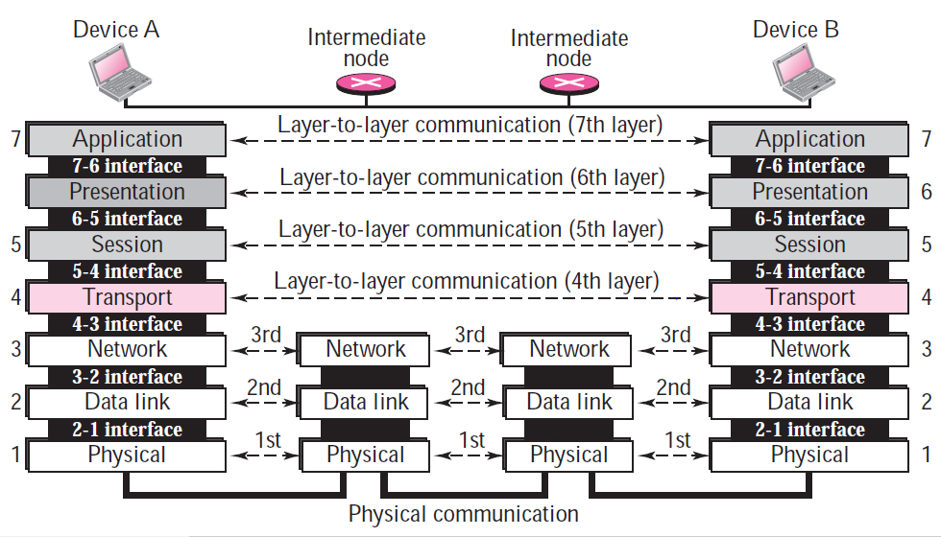
COMPUTER NETWORKS
OSI reference model (more)
User support layers
Heart
Network support layers

Slide 5
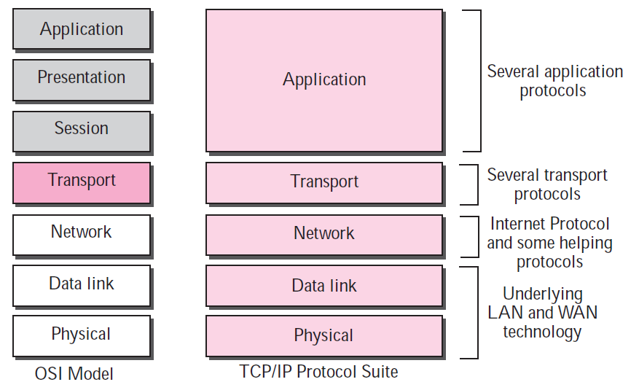
COMPUTER NETWORKS
TCP/IP vs OSI reference model

Slide 6
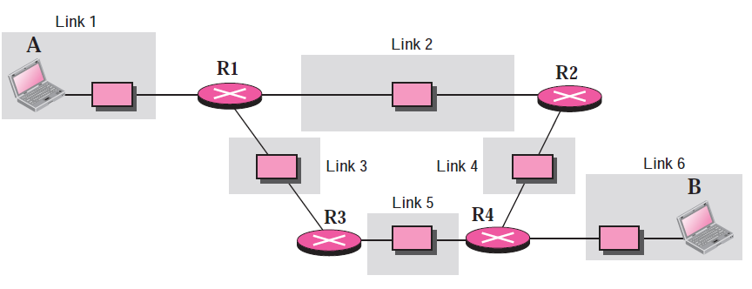
COMPUTER NETWORKS
Layers in the TCP/IP Protocol Suite (more)
A private internet

Slide 7
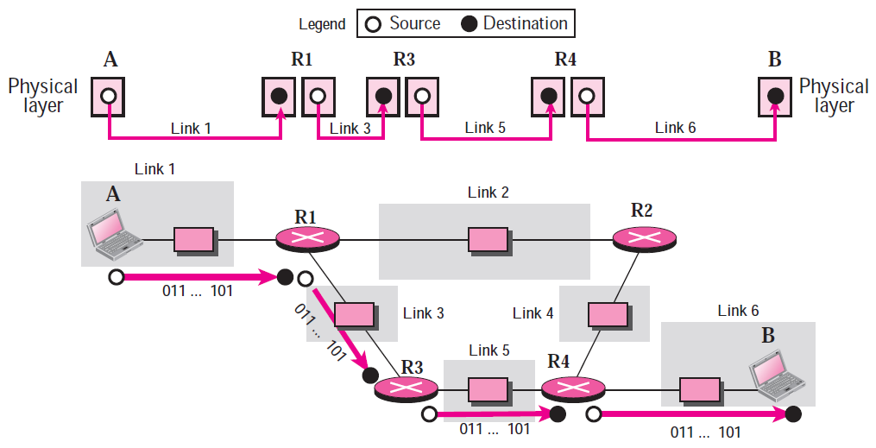
COMPUTER NETWORKS
Layers in the TCP/IP Protocol Suite (more)
Communication at the physical layer
Unit of Communication – bit

Slide 8
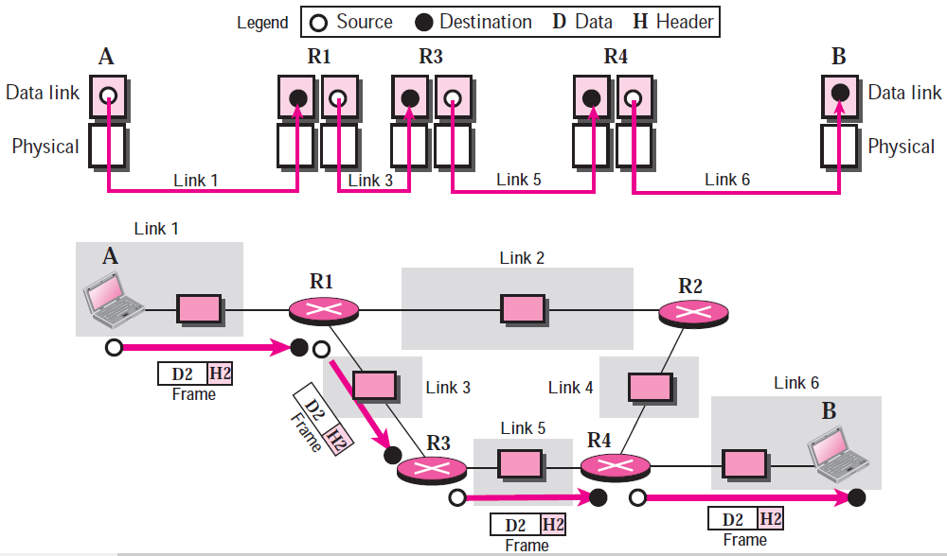
COMPUTER NETWORKS
Layers in the TCP/IP Protocol Suite (more)
Communication at the data link layer
Unit of Communication – frame

Slide 9
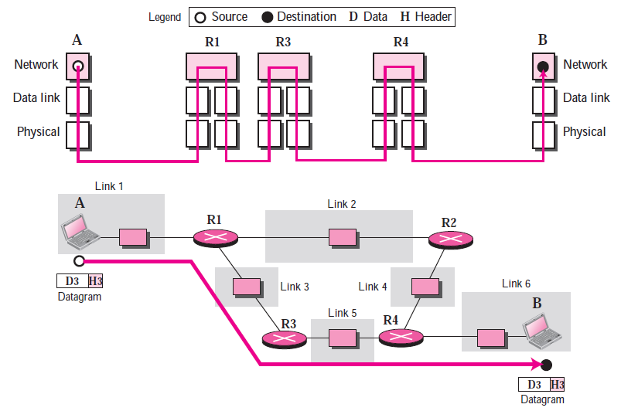
COMPUTER NETWORKS
Layers in the TCP/IP Protocol Suite (more)
Communication at the network layer
Unit of Communication – datagram

Slide 10
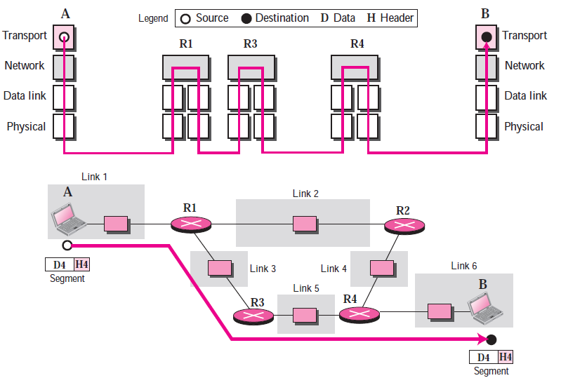
COMPUTER NETWORKS
Layers in the TCP/IP Protocol Suite (more)
Communication at the transport layer
Unit of Communication – segment/packet

Slide 11
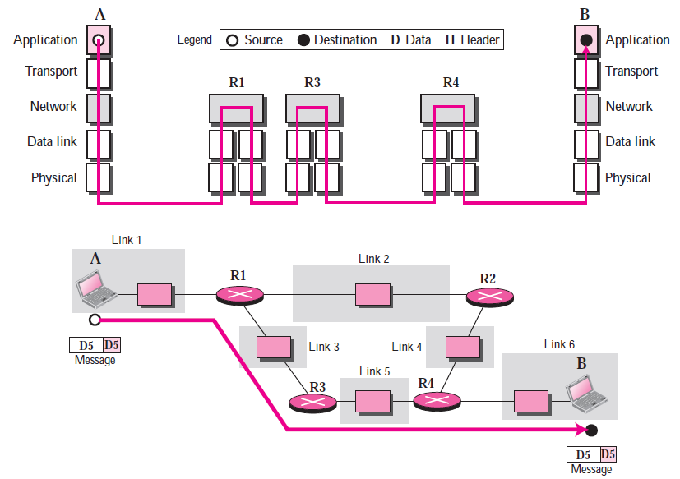
COMPUTER NETWORKS
Layers in the TCP/IP Protocol Suite (more)
Communication at the application layer
Unit of Communication – message

Slide 12

COMPUTER NETWORKS
Encapsulation – Data Communication in Protocol Stack
source
message
M
application
transport
network
link
physical
segment
H_{t}
M
H_{t}
datagram
H_{n}
H_{n}
H_{t}
M
frame
H_{l}
H_{n}
H_{t}
M
link
physical
switch
destination
H_{n}
H_{t}
M
network
link
physical
M
application
transport
network
link
physical
H_{l}
H_{n}
H_{t}
M
H_{n}
H_{t}
M
H_{t}
M
H_{n}
H_{t}
M
H_{l}
H_{n}
H_{t}
M
router

Slide 13

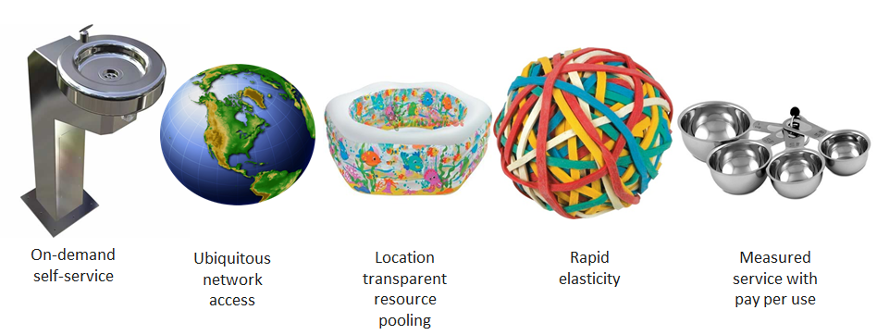
COMPUTER NETWORKS
Cloud Computing
Definition
Cloud computing is a model
for enabling ubiquitous, convenient, on-demand network access
a shared pool of configurable computing resources (e.g., networks, servers, storage, applications, and services)
can be rapidly provisioned and released with minimal management effort or service provider interaction.
This cloud model is composed of:
five essential characteristics
three service models
four deployment models

Slide 14
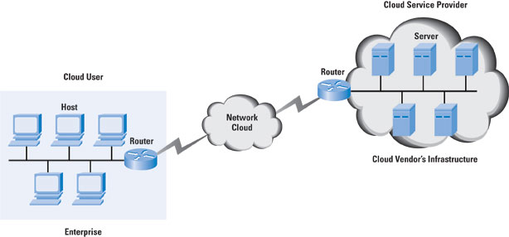
COMPUTER NETWORKS
Cloud Computing
Cloud Networking (SD-CN)
Hosting some or all of an organization’s networking resources/services from the cloud.
Network -> cloud-enabled or entirely cloud-based.

Slide 15
COMPUTER NETWORKS
Cloud Computing
Cloud enabled networking
Network is on premises, but some or all resources used to manage it are in the cloud.
Core network infrastructure – packet forwarding, routing, and data— remains in-house.
Others like network management, monitoring, maintenance, and security services are done through the cloud.
Cloud based networking
Entire network is in the cloud.
Includes network management resources and physical hardware

Slide 16
COMPUTER NETWORKS
Summary
We’ve covered a “ton” of material!
Computer Networks overview
Internet overview
what’s a protocol?
network edge, access network, core
packet-switching versus circuit-switching
Internet structure
performance: loss, delay, throughput
layering, service models
Introduction to cloud computing
You now have:
context, overview, vocabulary, “feel” of networking
more depth, detail, and fun to follow!

Slide 17


COMPUTER NETWORKS
Queries

Slide 18
THANK YOU
Sivaraman Eswaran Ph.D.
Department of Computer Science and Engineering
sivaramane@pes.edu
+91 80 6666 3333 Extn 834

